Slide 1
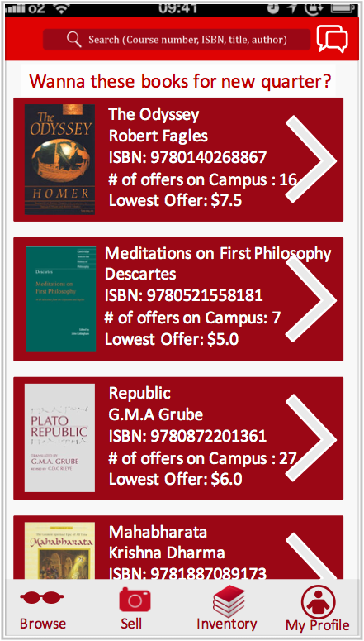

seller:
home page

Slide 2
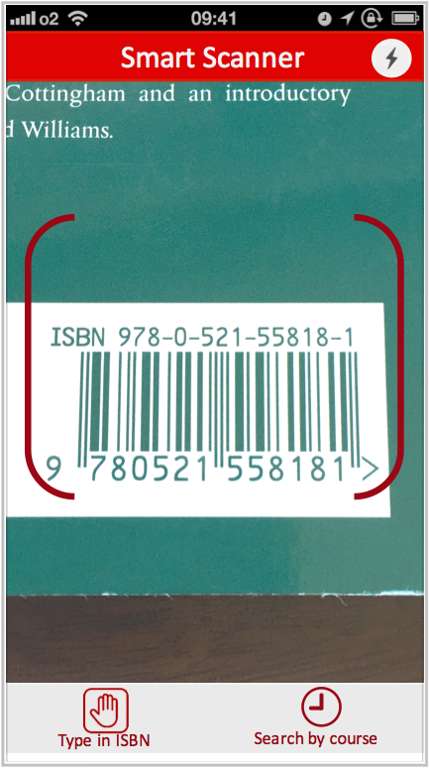
seller:
Scan barcode

Slide 3
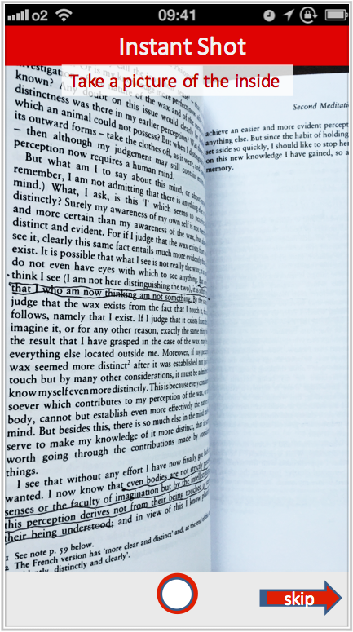
seller:
Take photos

Slide 4
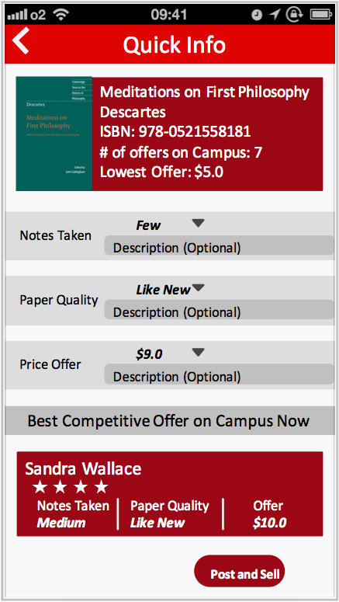

seller:
book info

Slide 5


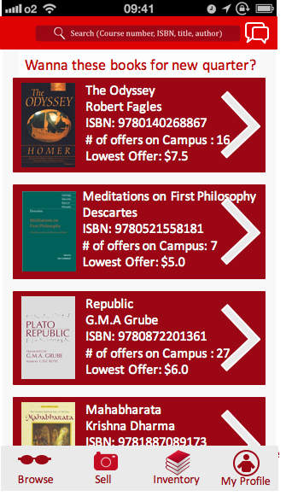
Buyer:
home page
type in course number

Slide 6
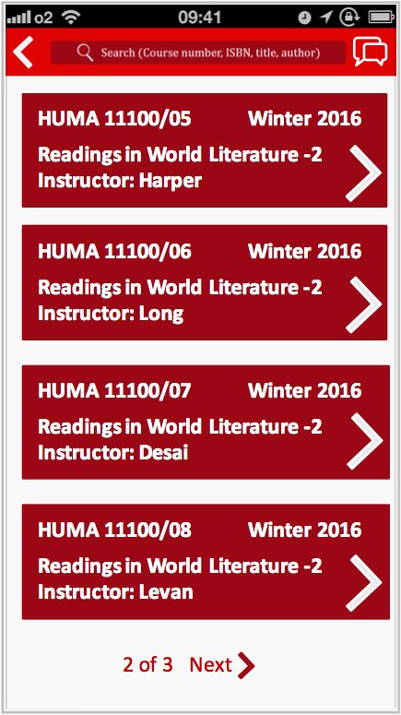

buyer:
course confirmation

Slide 7
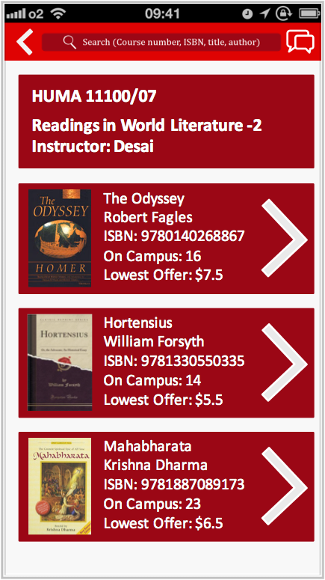
buyer:
book list

Slide 8
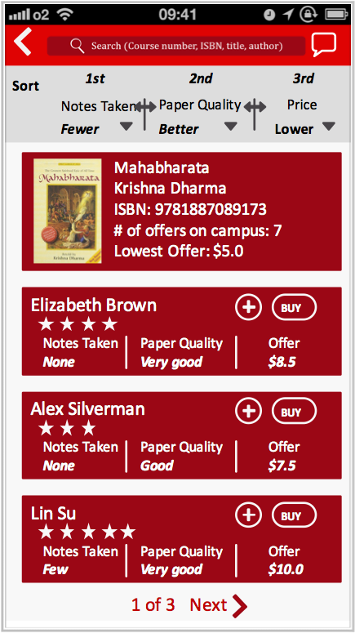

buyer:
offer list

Slide 9
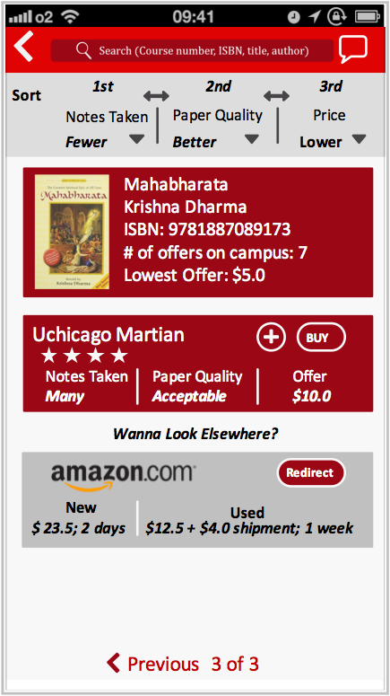
buyer:
offer list

Slide 10
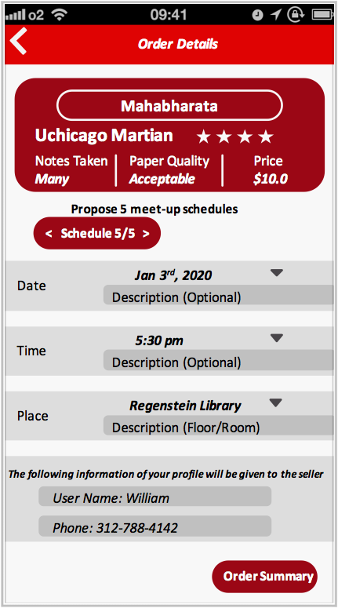

buyer:
Propose Meet-up schedule

Slide 11
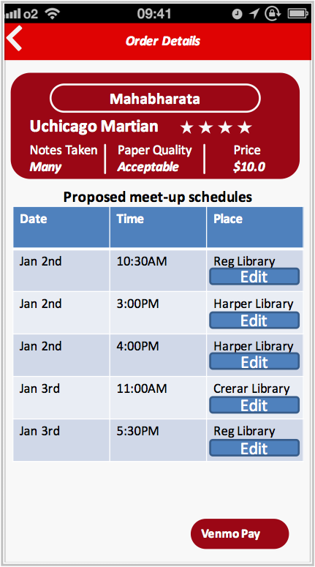
buyer:
pay to escrow account via venmo

Slide 12
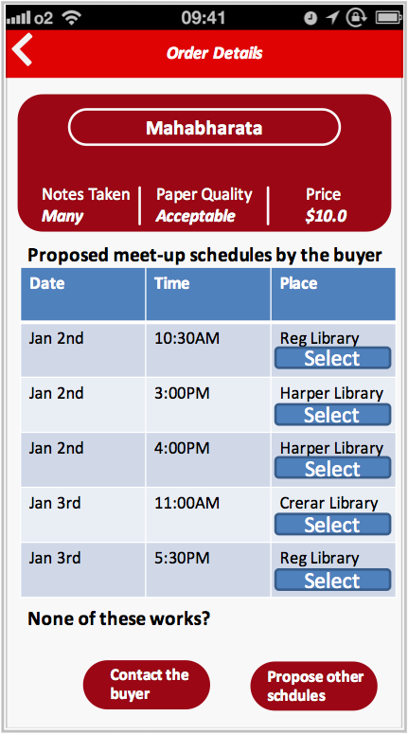

seller:
receive notification & select proposed schedules

Slide 13
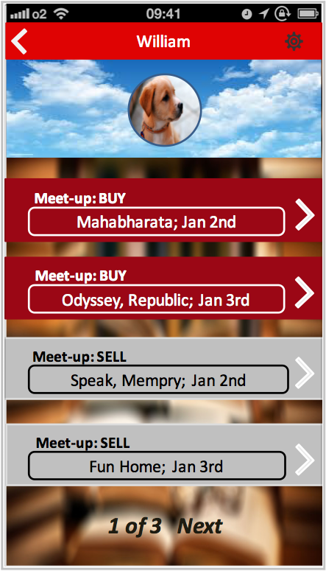
buyer:
receive notification

Slide 14
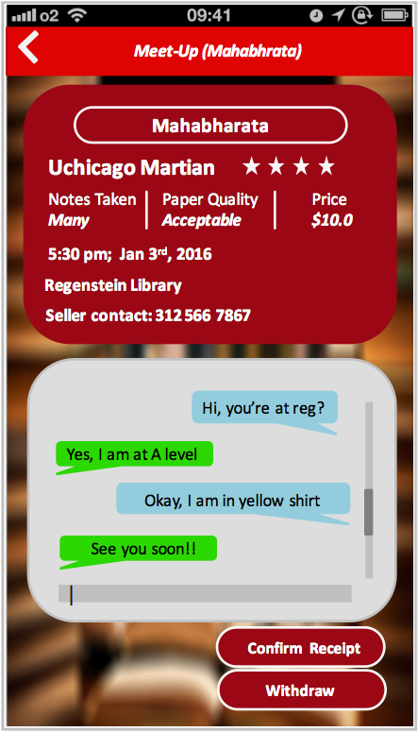

buyer & seller meet-up

Slide 15
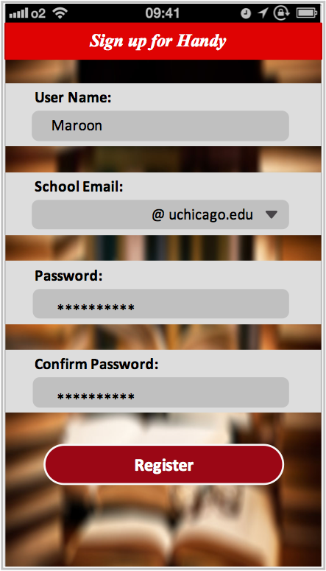
registration

